Slide 1

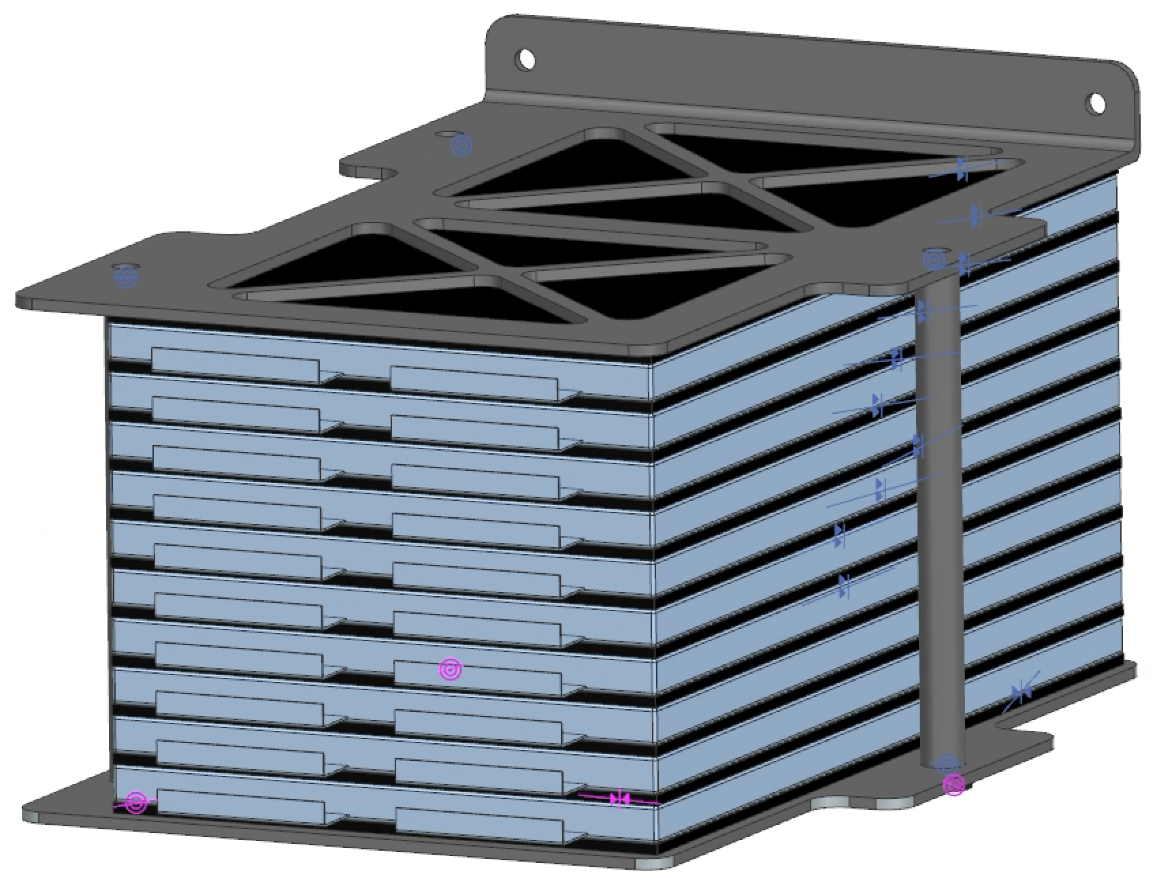
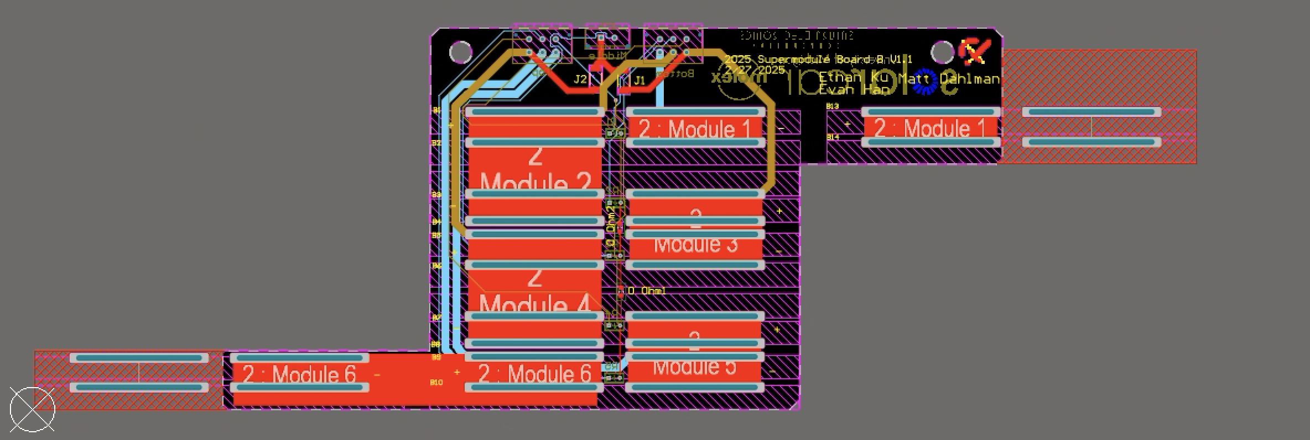
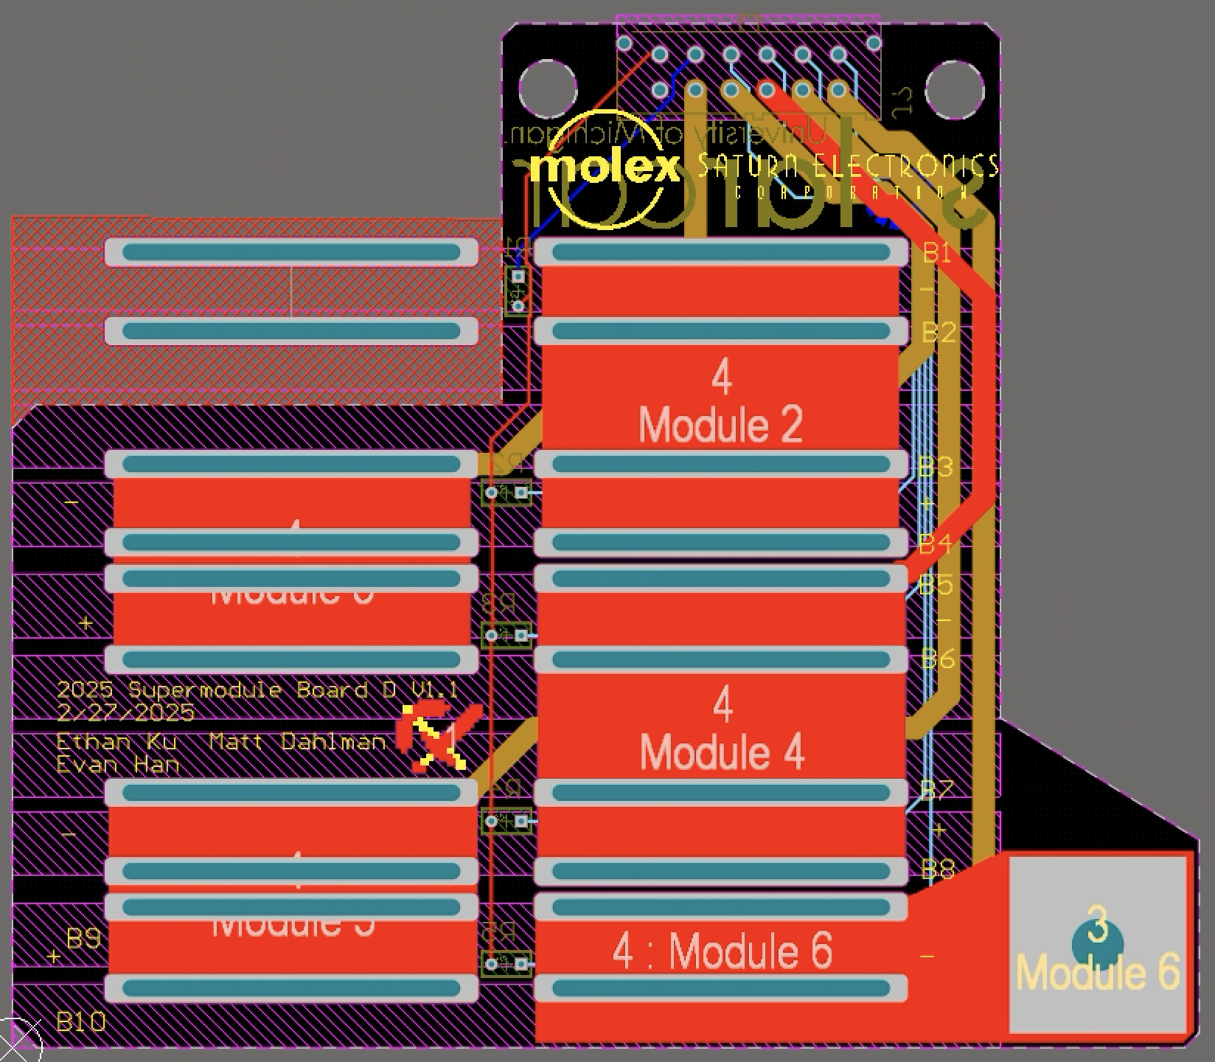
Microsystems Engineer
Battery Supermodule design with geometric improvement for improved safety by eliminating high voltage copper bus bars
100% functionality of car battery: series-parallel connections create capacity for travelling 3000+ km in Bridgestone World Solar Challenge (7th place)
Teamcenter/NX CAD dimension fitting

Slide 2
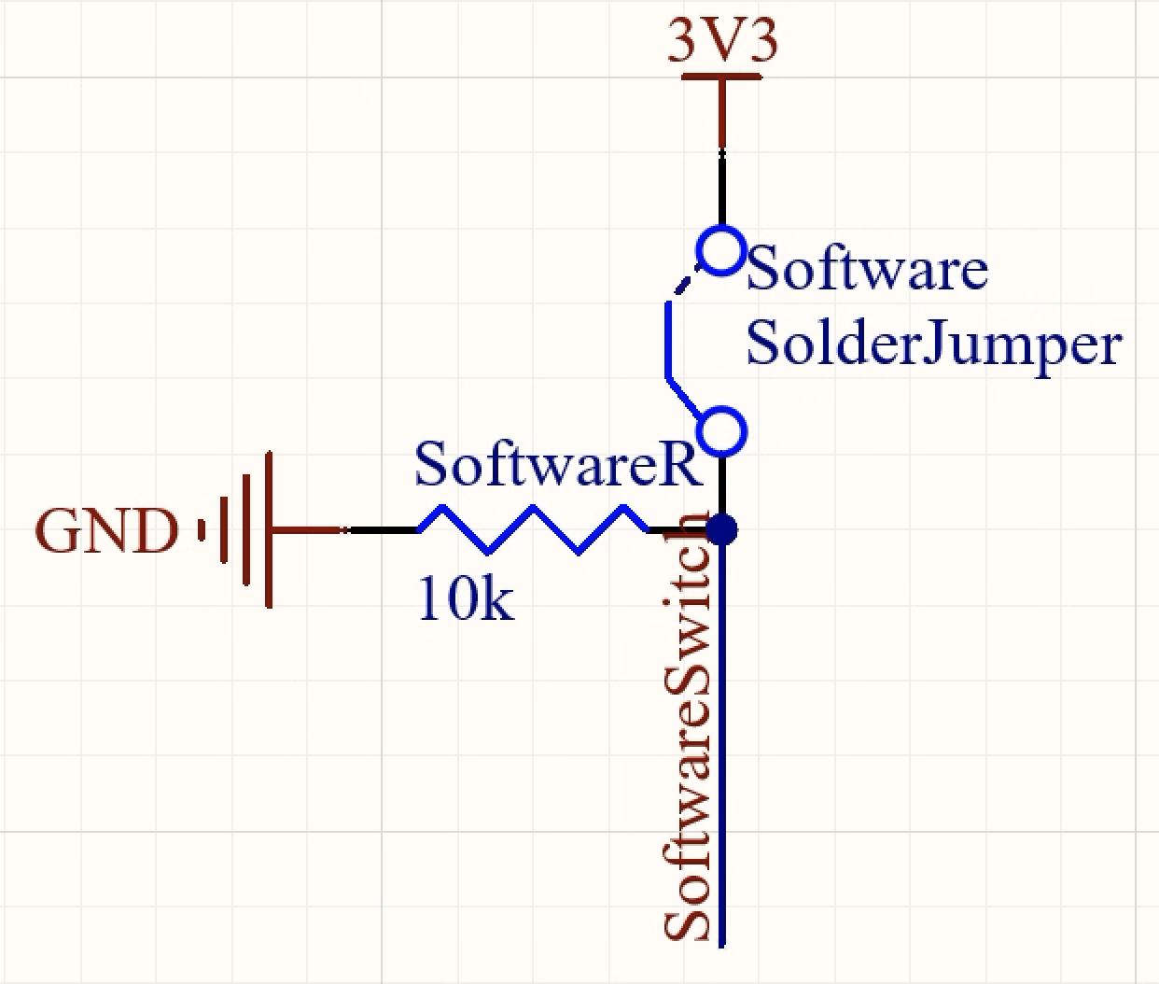
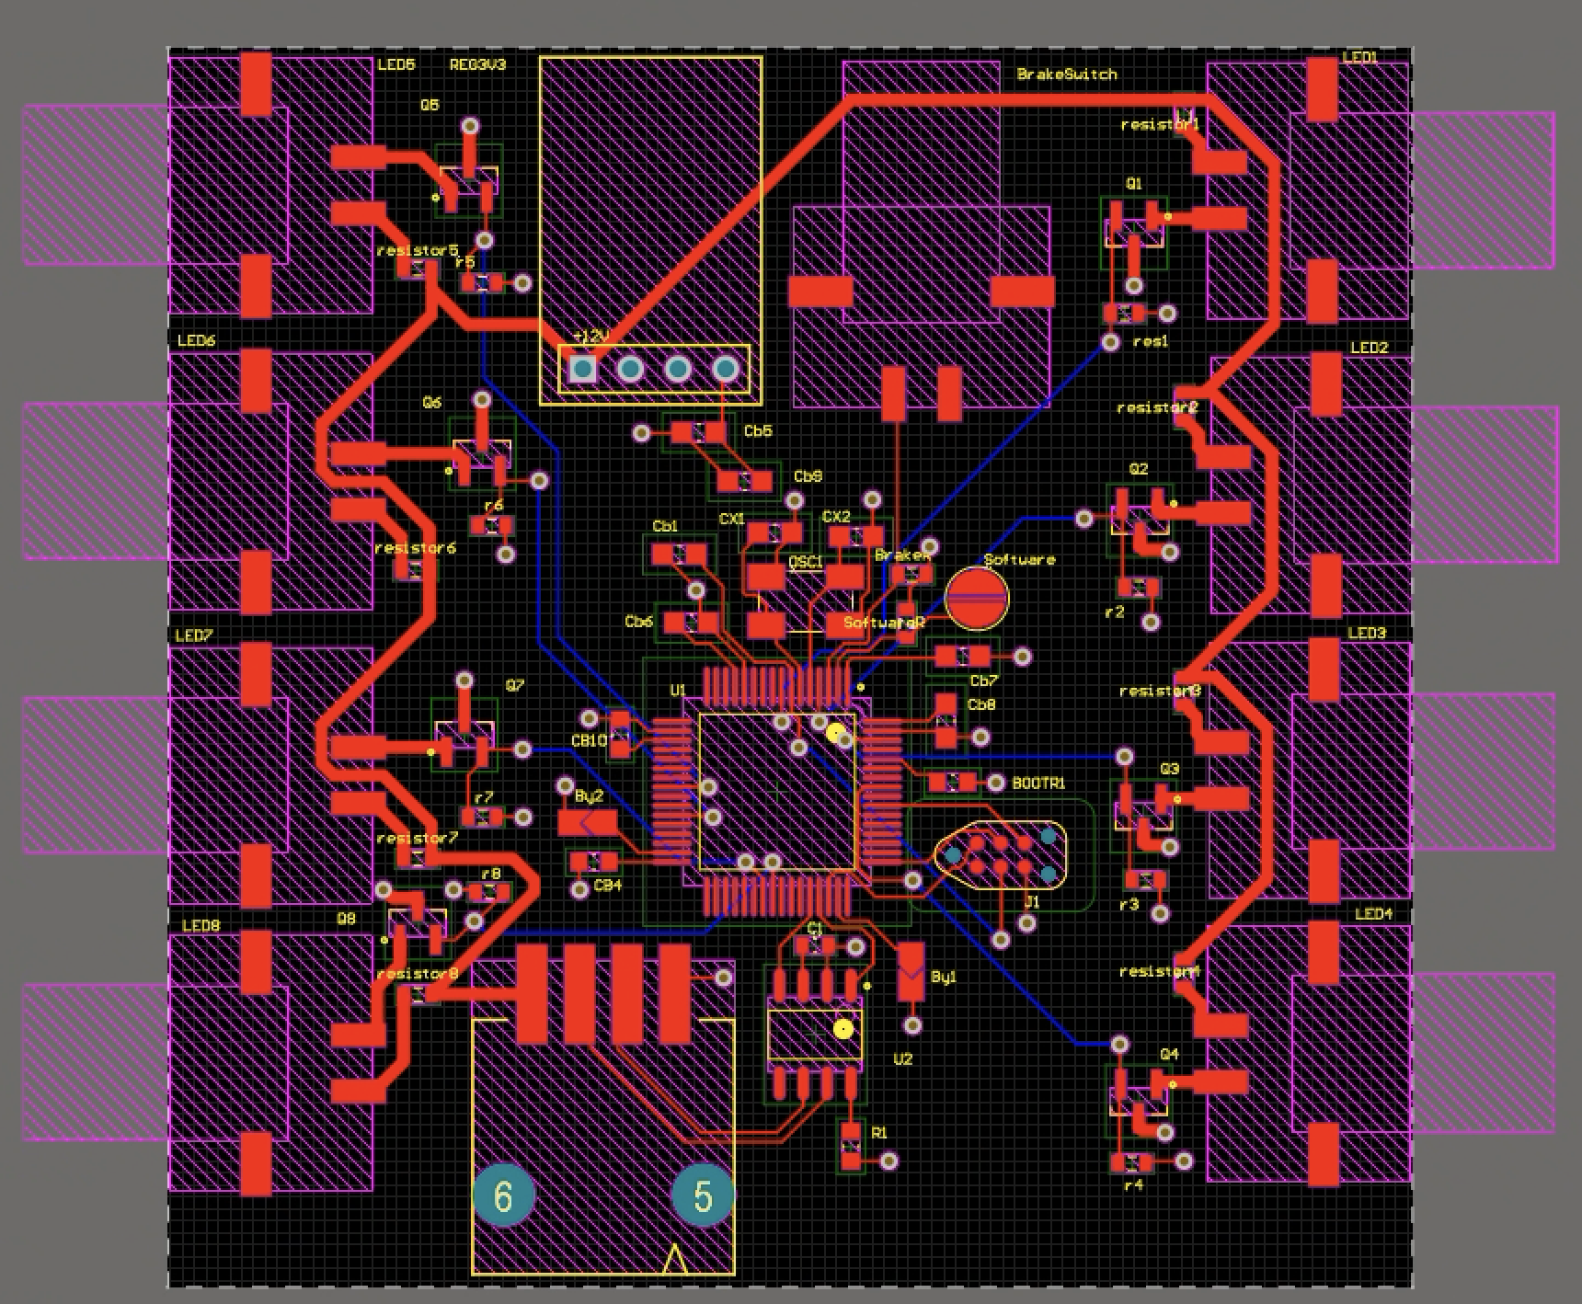
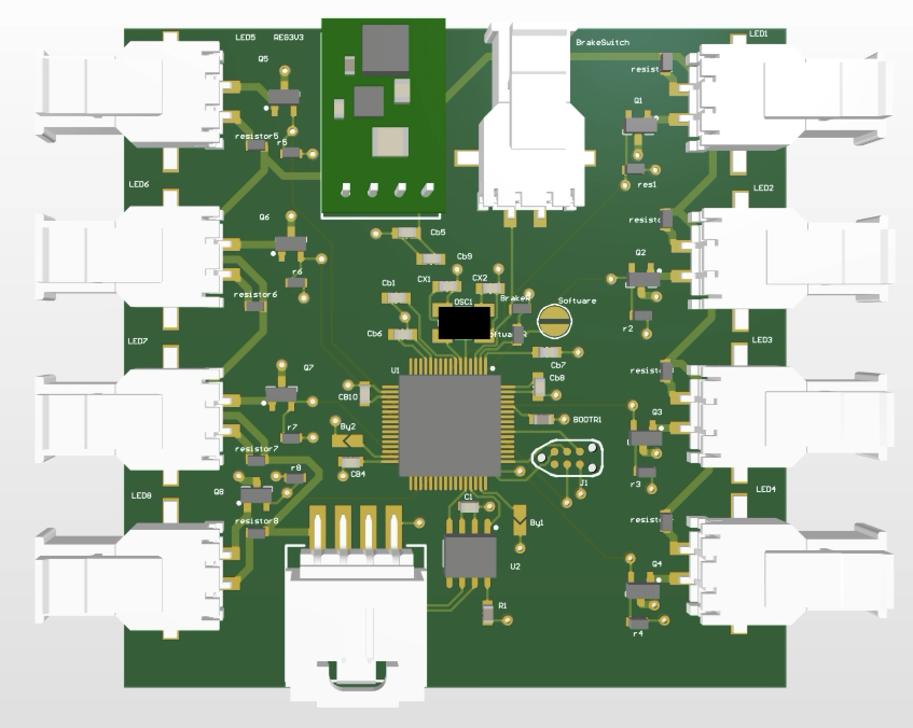
Microsystems Engineer
Brake Light board with solder jumper design to set software logic for front or back brakes, pulling to GND or connecting based on solder connection
50% decreased inventory clutter improving limited travel team storage space

Slide 3

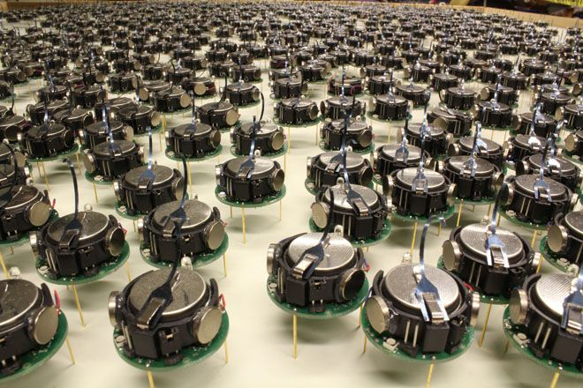
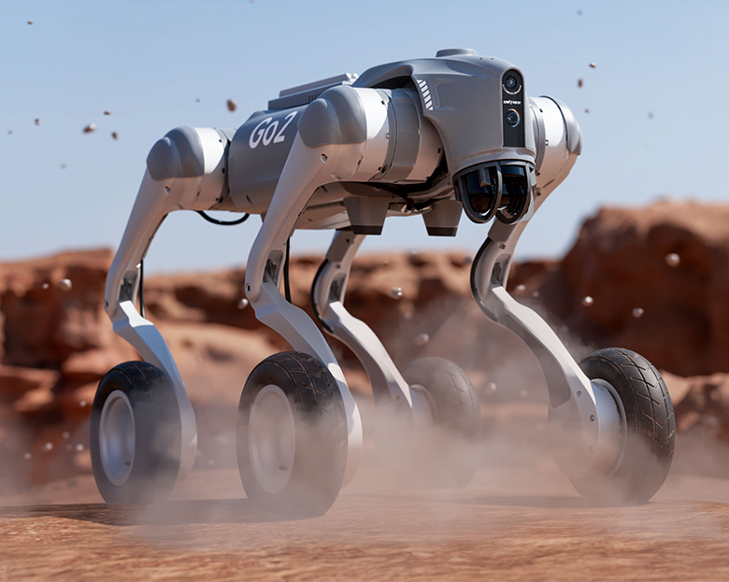

Research Assistant
Led design of PDB on mobile robot chassis by reviewing and implementing past practices and new component requirements, ensuring power needs for 4 new components, and verifying criteria for continued V1 components
Integrating 2 new sensors on robot chassis for real-time localized navigation via SLAM, communicating with ROS2
Implemented Notion with team of 5-10 by reviewing old Google Drive ineffiencies and matching identified team needs with modern management software for 85% increased information access and task deployment efficiency

Slide 4

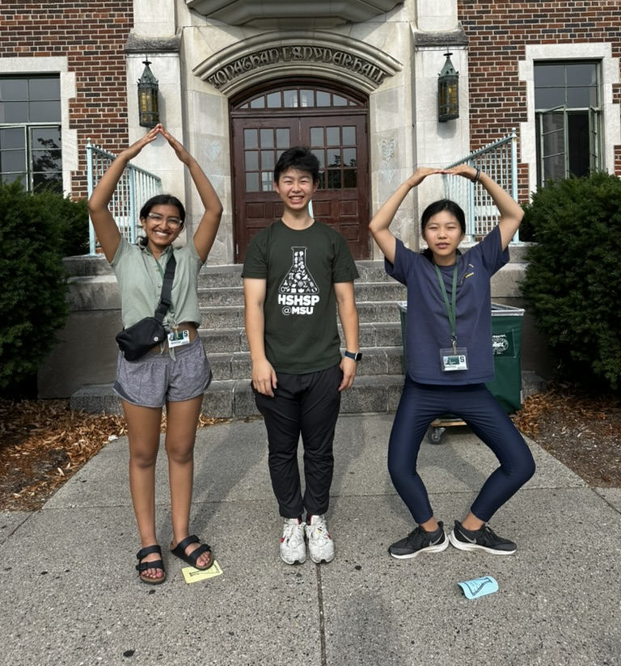
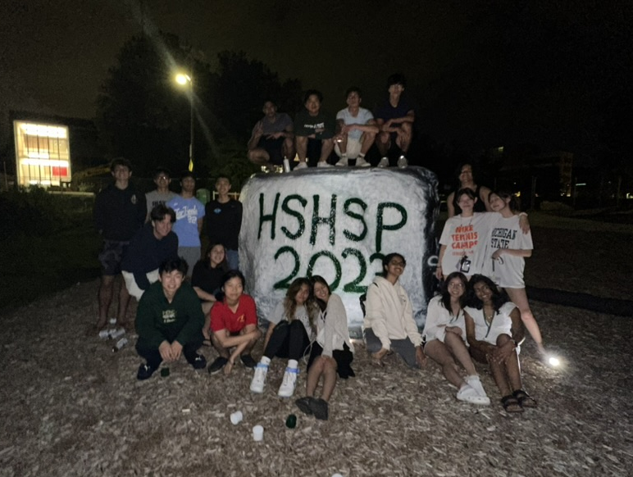
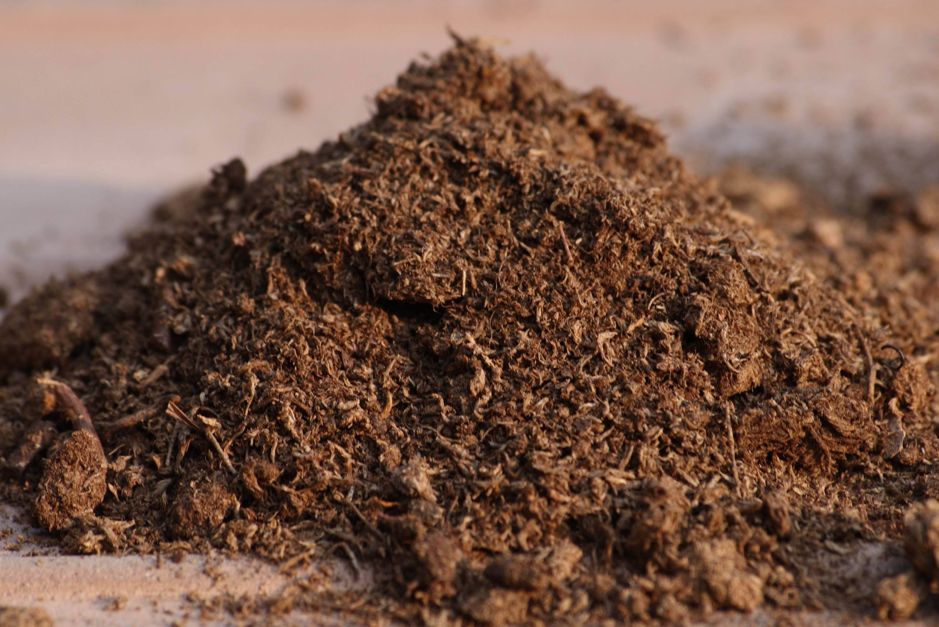
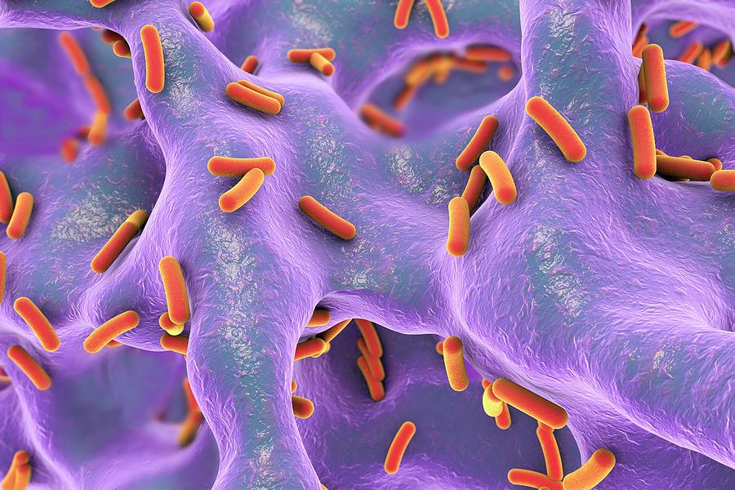
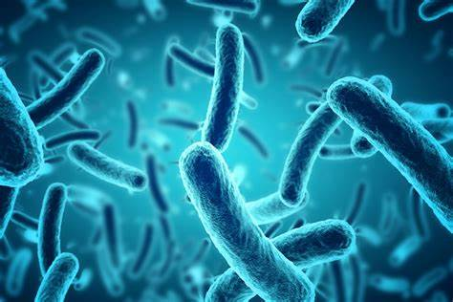

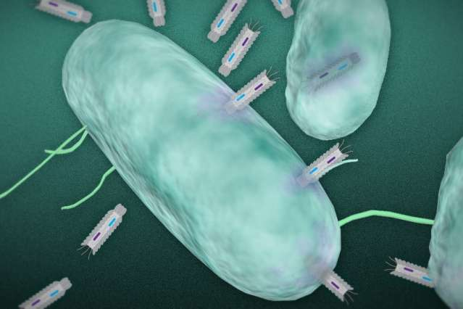

Research Assistant
HSHSP Program (2023)
Publication: D. T. Islam, E. Telli, N. Telli, H. Fatteh, I. Ma, E. Ku, S. Kotaru, W. Hanim, P. Hatzinger, B. Upham, M. Williams, G. Zylstra, D. Fennell, A. Cupples, S. Hashsham. (2023). “Targeted Sequencing Panel to Characterize the Respiration of Polychlorinated Dibenzo-p-dioxins and Dibenzofurans by Dehalococcoides mccartyi Strains”. Annual Superfund Research Project Meeting, Albuquerque, New Mexico, 2023
Reproduced from wonderfuldiy.com
Reproduced from adobe.com
Reproduced from usc.edu
Reproduced from pluspng.com
Reproduced from oeconline.org
Reproduced from mit.edu
Notes:
The research was on developing Strand-Exchange Amplification, a new method that is faster than qPCR, for specific antimicrobial resistance genes. The idea is that once you place a sample, you should be able to rapidly deduce whether that sample contains antimicrobial resistance genes. This applies to various fields, such as, in our case, the environmental pollutant Dioxins.

Slide 5

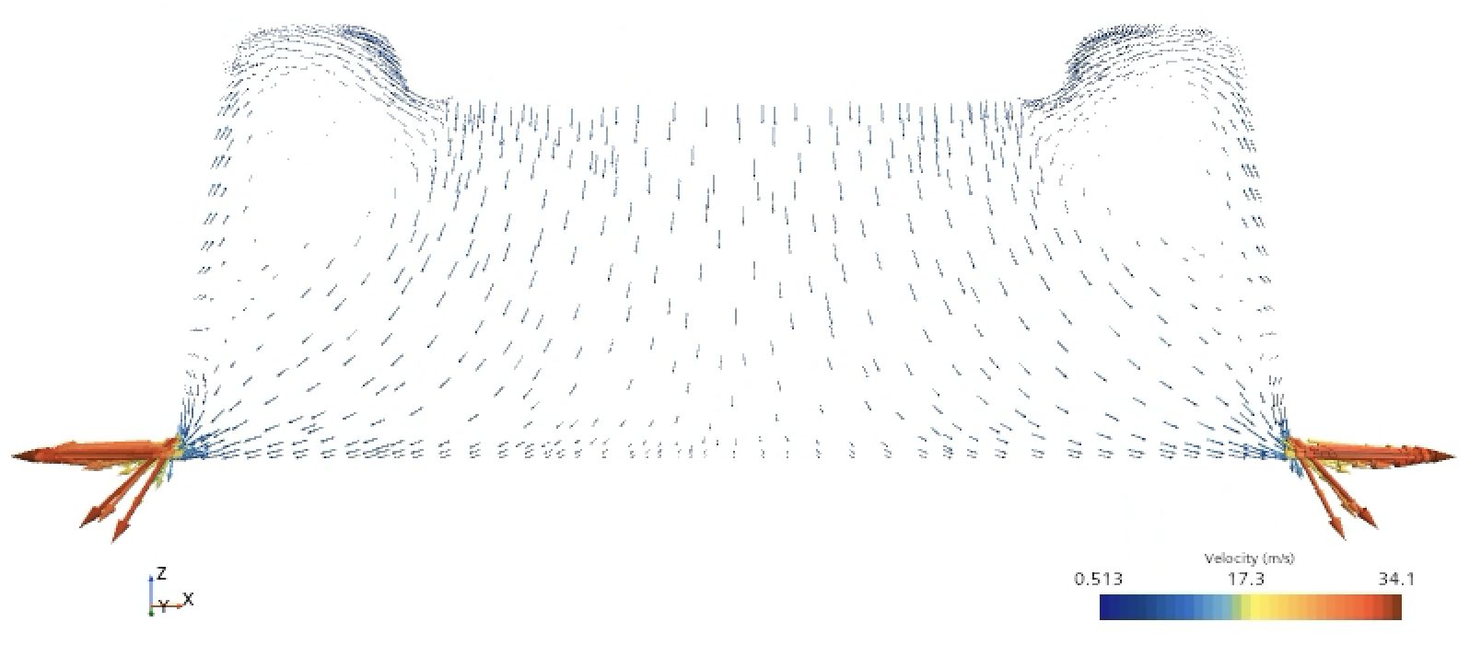
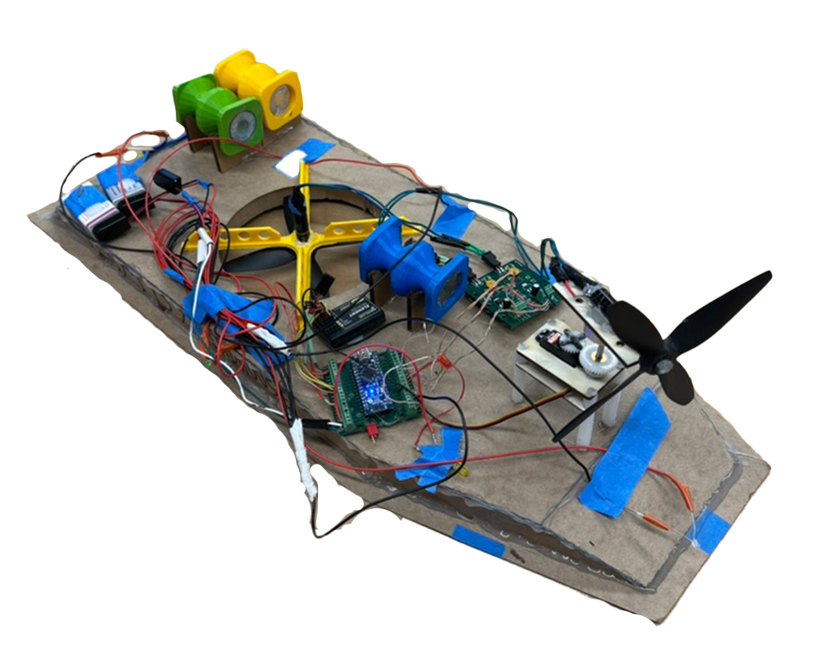
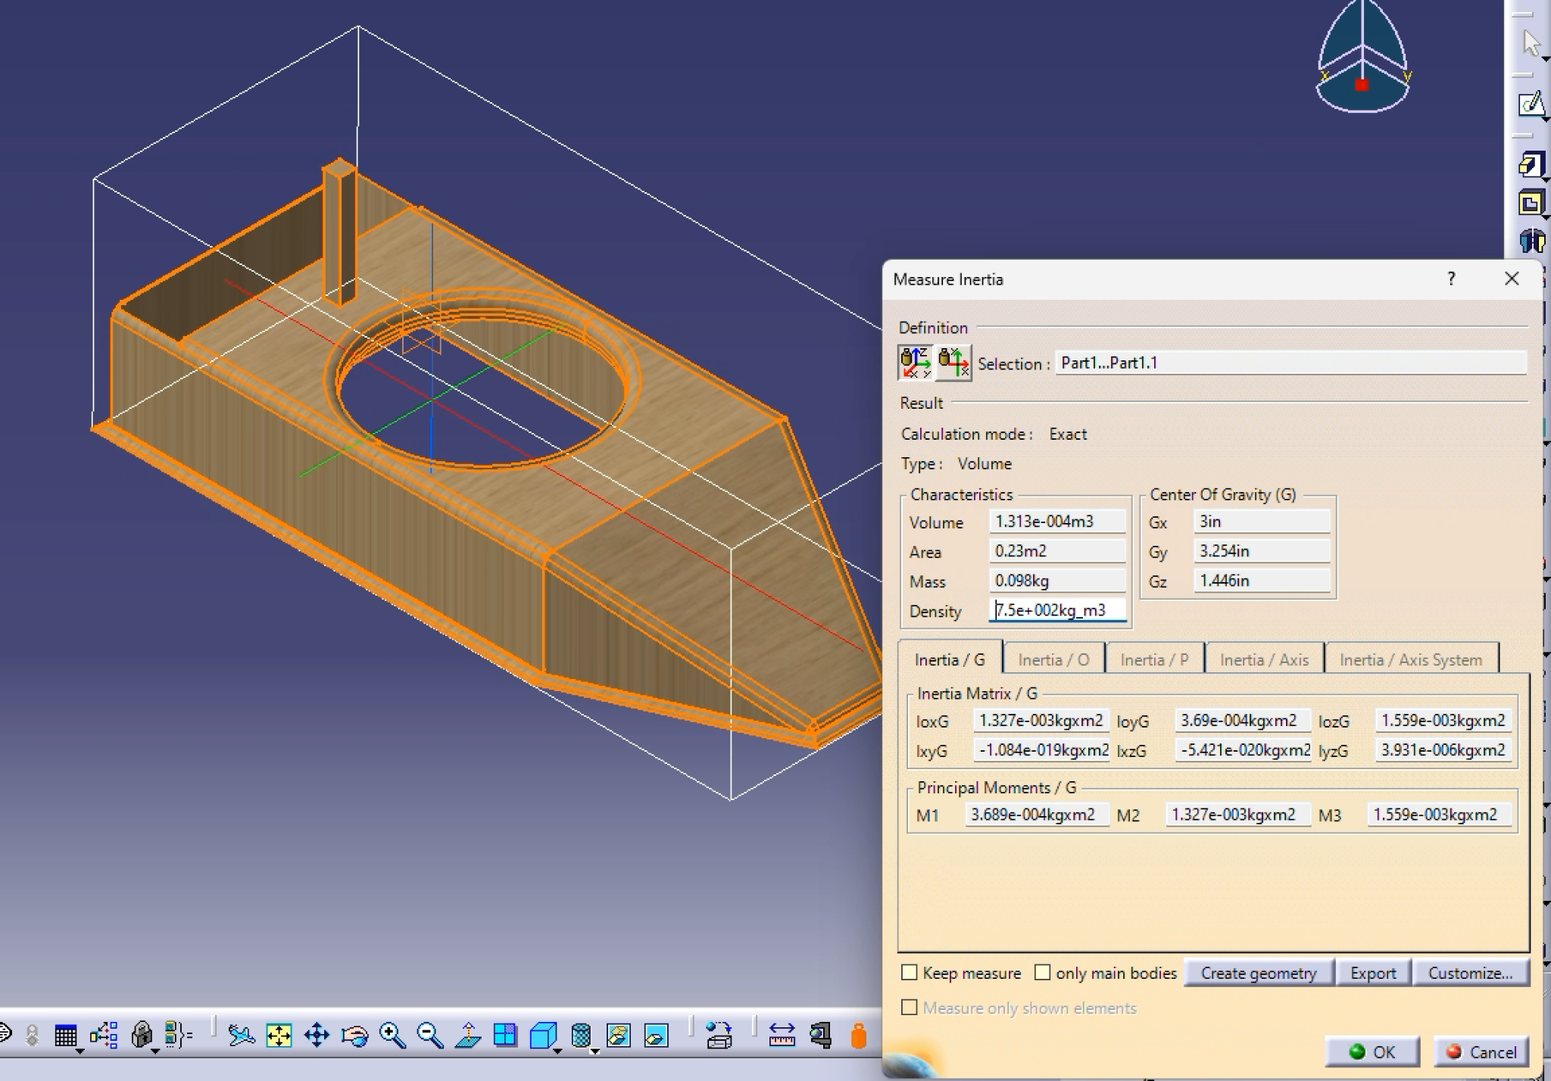
Team Member (Class)
Developed 2 full-scale remote controlled hovercraft with team of 5, capable of delivering payloads up to 100g
Led integration of MOSFET connections to battery, directional servo firmware, and LEDs per nautical regulations

